Slide 1

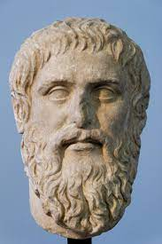





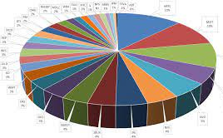
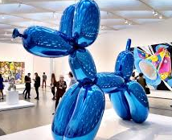



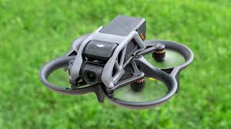



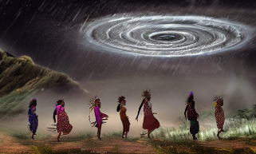
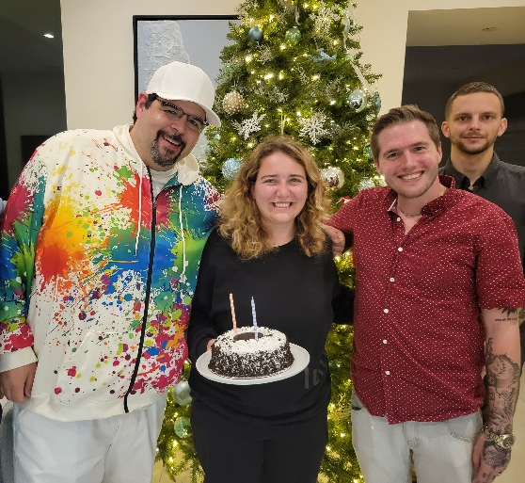
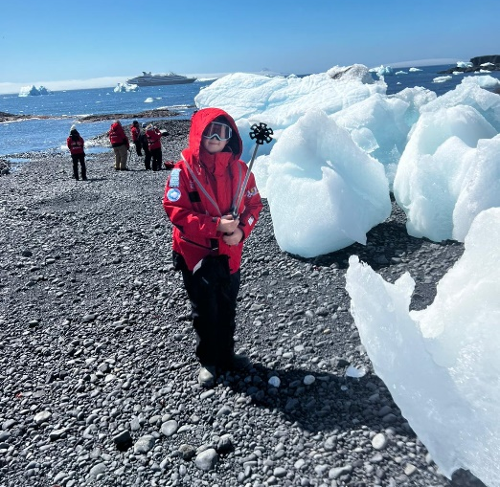
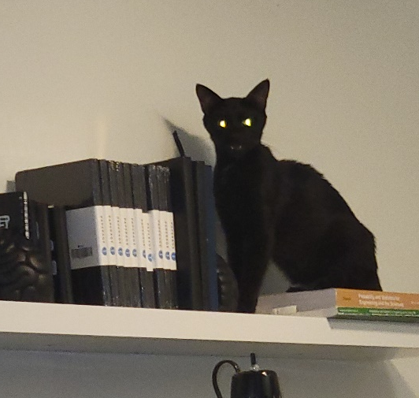
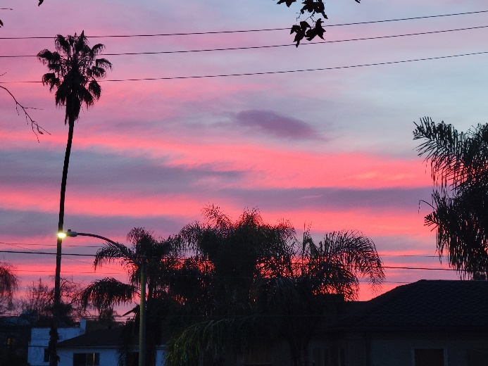
Andrew W. Taylor – M.S. in A.I. Candidate at JHU, Background Slide
Education | Work Experience | Professional Expertise | Personal Interests
Global Philosophy | Kid Castle Taipei | Banking | Weight Training
Classical and Modern Chinese Language |  | Investments | Museums
Financial Advising |  | Wealth Planning | Drone Piloting
Financial Analysis |  | Forecasting | A.I. Art and Animation
Andrew and Friends
Thomas, my son, at the South Pole
Sally the stray
…in the City of Angels.

